Slide 1
NICU Length of Stay
How Can We Improve?
What is Value?
Joe Kaempf, MD
Providence Health System Women and Children’s Services
Portland, OR
October 2020

Slide 2
Disclaimer
I have no conflicts of interest to disclose.
The Vermont Oxford Network played no role in the design, analysis, interpretation or reporting of this presentation. The views, conclusions, and opinions expressed are solely mine and do not represent the Vermont Oxford Network.

Slide 3
Value
Health Benefits Obtained/Resources Consumed
Quality
Do we consistently get the specific health goal we wish from ‘X’?
Impact
Which benefits are most important?
Where are we devoting resources/money/time/energy?
Who is receiving the above?
How do we balance what is ‘do-able’ with what is high impact?
Prioritize
Low-Hanging Fruit for inclusion, QI experience and team-building
Mid- and High-Hanging Fruit in the resource consuming sectors

Slide 4
Improve Population Health
Improve Individual Reduce per Capita
Care – ‘STEEEP’ Cost
Triple Aim = Value equation
Improve Population Health + Improve Individual Care ‘STEEEP’/Reduce per Capita Cost

Slide 5
NICUs are no longer “profit centers”
NICUs are $$$ losers for many hospitals
#1 NICU cost – Staffing
Staffing is driven by Acuity and Census
Acuity is driven by GA, BWT, therapies recommended, surgical and tertiary services,…..and morbidity rates
Census is driven by # of admissions,……and
Length of Stay (LOS)

Slide 6
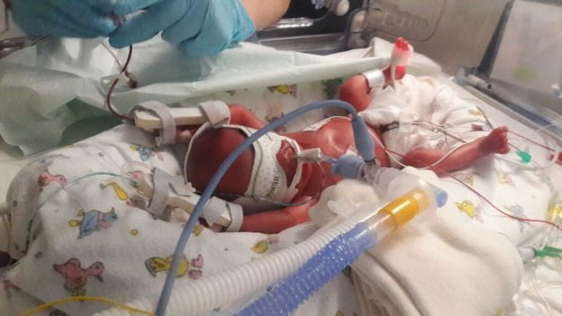
Which of those can you influence?
Gestational age?
Therapies offered?
Improved morbidity rates?
Other?
Many factors affect length of
stay,….it’s a tangled web.

Slide 7
<32 weeks 32-36 weeks 37-42 weeks
USA Births 2% 9% 89%
NICU Admits 15% 70% 15%
Bed Days 40% 45% 15%
Acuity High Low Variable
PMA at discharge is greater for infants born at 23-28 weeks compared to 29-36 week infants

Slide 8
VON Survival 2000 2017
24 Wks 58% 64%
Length of Stay
24 Wks 132 d (@43 wks)
28 Wks 73 d (@38 wks)
25% of surviving 24 week infants are in the hospital
5 months or more.

Slide 9
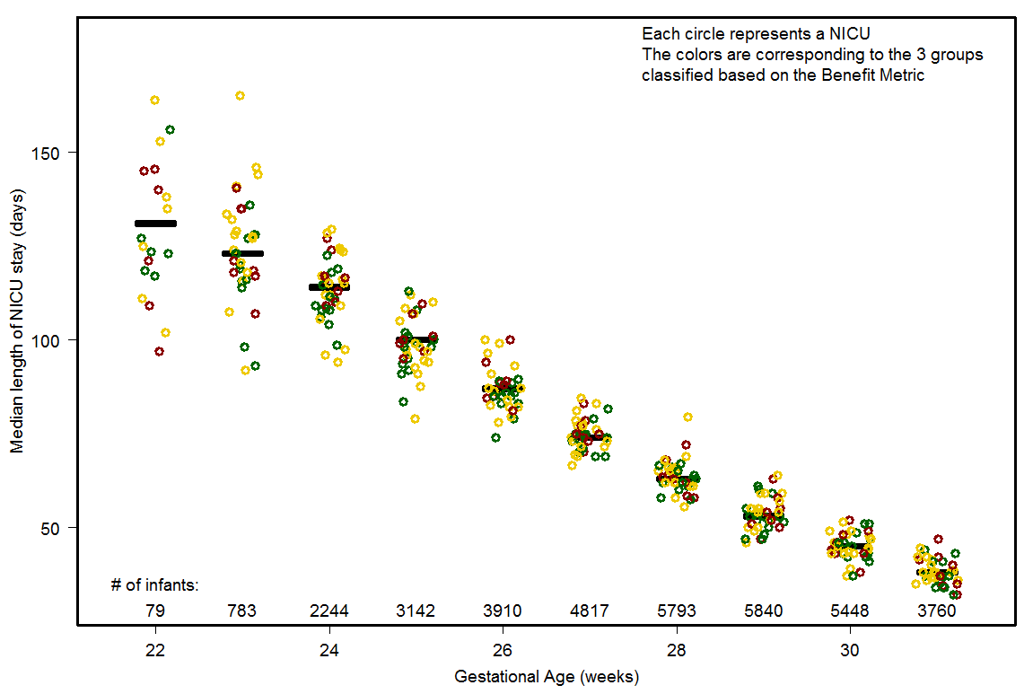
Median Length of NICU Stay
VLBW infants
2000 to 2014
39 NICUs
Proficiency via
Benefit Metric
Green – high
proficiency
Yellow – average
Red – lower
proficiency
Kaempf et al, Arch Dis Child FNN, 2018
2 high proficiency NICUs as ranked by the Benefit Metric
25 week survivors have a 32 day difference in median LOS,….why?
Notes:
Wide variation in Median as well from NICU to NICU for each GA week.

Slide 10
Seaton, et al BMJ Open 2016
Systematic review of factors that predict NICU LOS
5042 studies but only 9 studies met “LOS prediction criteria”
Gestational Age Birth Weight Sex
“The ability to predict LOS Day 1 would be valuable,….dynamic adjustment would be helpful,….organizational factors are sizable and not quantitated,….a meta-analysis was not possible due to methodologic variability.”

Slide 11
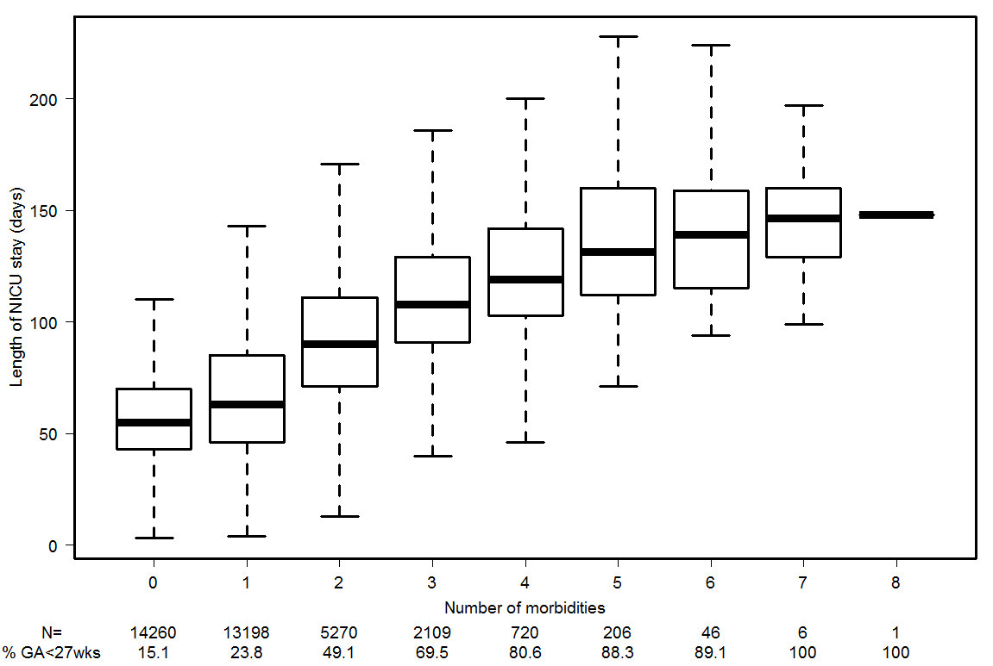
The more premature,
the more morbidities
suffered.
More morbidities,
longer the length of stay. Kaempf et al

Slide 12
Length of Stay Risk-adjustment Take Home Message
Gestational Age
Birth Weight explains ~50% of LOS variance
Sex
CRIB/SNAPPE Score
C/S vs Vaginal ups it to ~60% LOS variance
Inborn vs Outborn
Maternal socio-economic factors
Geography

Slide 13
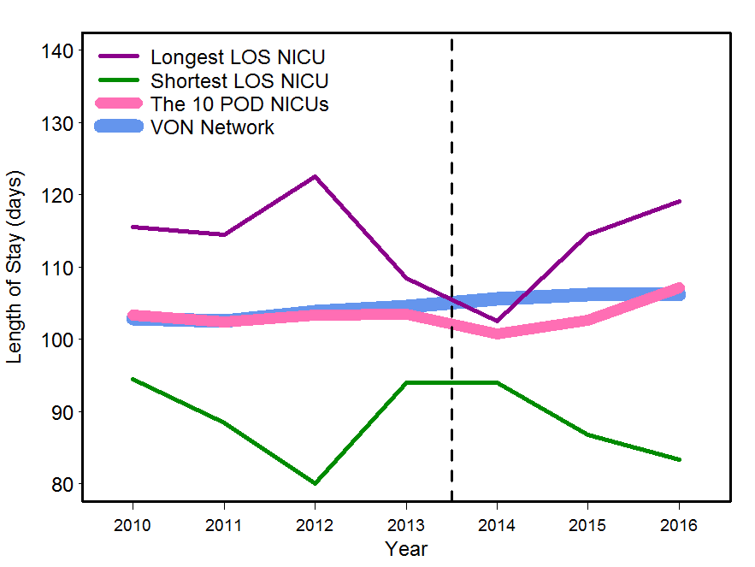
Risk-adjusted - Green NICU has fewer morbidities than Purple NICU,
and 30 day difference in LOS.
~$120,000 per baby
Kaempf et al, JAMA Peds 2015

Slide 14
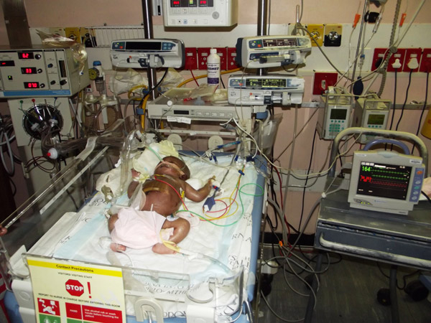
Reducing major morbidities – BPD, NEC, nosocomial infection, SIVH, SROP, PVL generally
decreases the LOS.
With major morbidities
factored in, ~75% of the LOS
variance can be explained,….
but what accounts for the
other ~25%?

Slide 15
Morbidities are intertwined with decreasing GA and BWT,…..horse or cart as we study LOS?
CPQCC data - mortality rate has negligible effect on LOS and Total Bed Days,….ditto for transfer rates. H Lee, J Perinatol, 2013
NICUs that have fewer morbidities in extremely premature infants report reduced mortality which can increase total bed days.

Slide 16
LOS is 4–dimensional, it’s quantum,….non-linear interactions in complex adaptive systems.
You cannot predict the performance of any whole by simply studying the parts.
NICUs are networks composed of non-homogenous agents with competing interests,….interacting in undisclosed manners. There are no independent “parts”.
Kaempf and Suresh, J Perinatol, 2019

Slide 17
Let’s pause for a moment,…..what is missing from the NICU length of stay literature?

Slide 18
Where is the optimal position on this 3- dimensional undulant, magic carpet ride?
Optimal for whom?
The infant?
The family?
RNs/MDs/NNPs…?
Insurance companies?
Society-at-large?
LOS
Mortality
Morbidity

Slide 19
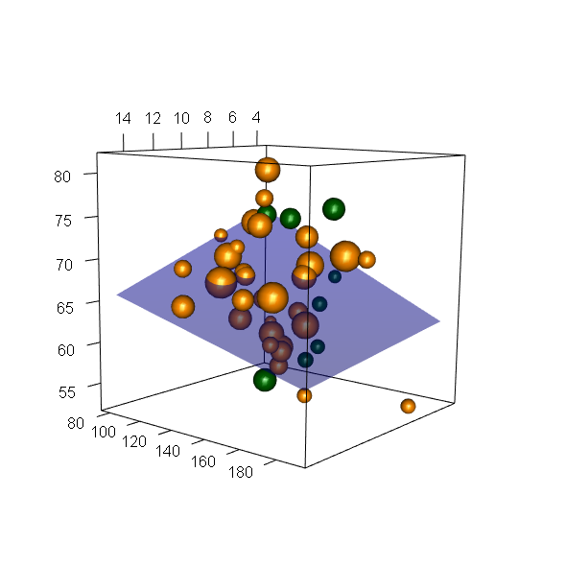
39 NICUs
“Benefit Metric” in 21,423 VLBW infants
LOS decreases as the morbidity score increases (improves)
LOS increases as mortality decreases
LOS increase seen with decreasing mortality is blunted by a better morbidity score
Mortality (MEED)
LOS
days
Wow!
Risk-adjusted Composite Morbidity Score
Kaempf et al, Arch Dis Child FNN, 2018

Slide 20
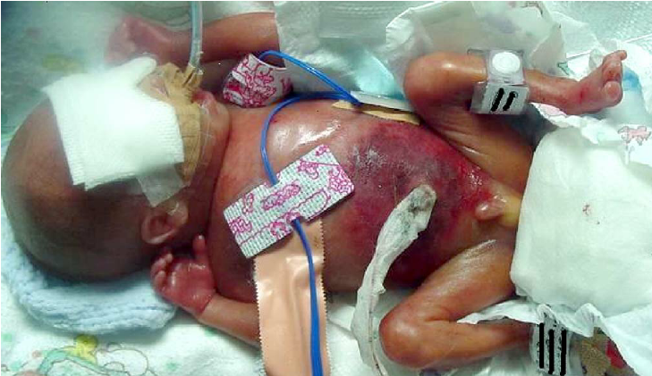
Neurodevelopmental outcomes in premature infants <28 weeks are not uniformly improving.
Cheong, Pediatrics, 2017
Burnett, Pediatrics, 2018
Twilhaar, JAMA Pediatrics, 2018
Spittle, Pediatrics, 2018
Adams-Chapman, Pediatrics, 2018
Nakanishi, J Perinatology 2018

Slide 21
If a premature infant is discharged home without BPD, Grade 3-4 IVH, Stage 3-4 ROP, PVL, NEC, FIP, nosocomial infection, or a D/C weight <10th percentile…..
likelihood of good long term health and neurodevelopment?
~90%

Slide 22
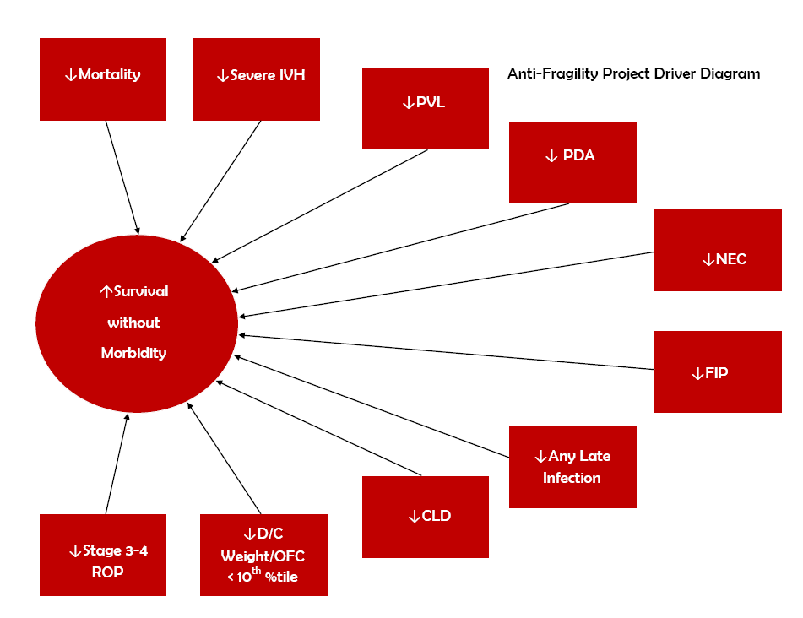
Goal
Move the Big Dot in VLBWs in the most proficient, efficient, family-centered fashion possible!
Heather Kaplan, MD

Slide 23
Take Home Message
and
Helpful Hints to Improve NICU LOS

Slide 24
Length of Stay Optimization Menu for <32 Week VLBWs
Enhance preconception obstetric care to reduce premature birth rate
Consensus periviability guidelines – shared decision-making, family informed choice
Optimize obstetric care – antenatal corticosteroids, MgSO4, placental transfusion, rational fetal monitoring, Golden Hour delivery room proficiency, skilled teamwork
Reduce major morbidities via evidence-based guidelines and standardization
Discharge-to-home pathway, clear expectations and family centered care
Breast milk promotion, feeding guidelines, cue-based nippling or IDF
Consistent apnea guidelines, spell-free definitions, pulse oximetry standards, judicious home monitor use
Immunization well before discharge target, consider outpatient herniorrhaphy
Practical car seat test guidelines with common sense flexibility
Creative Home Healthcare, RN visits, judicious home NG feeds, G-tubes
Quarterly multi-discipline review all <32 week infants discharged at >40
weeks.
Do-able EBM standardization and culture-of-excellence change. Yes.

Slide 25
Length of Stay Optimization Menu for 32-36 Week Infants
Discharge-to-home pathway, clear goals, expectations, family-centered care
R/O Sepsis guidelines – Kaiser calculator
RDS, TTN, and Jaundice guidelines and standardization
Breast milk promotion, feeding guidelines, cue-based nippling or IDF
Consistent apnea guidelines, spell-free definitions, pulse oximetry
standards, judicious home monitor use
6. Immunization schedule well before discharge target
7. Quarterly multi-discipline review all 32-36 week infants who are
discharged at >38 0/7 weeks
EBM/QI do-able,…this is the bulk of total bed days in many NICUs.

Slide 26
Length of Stay Optimization Menu for Term Infants
Discharge-to-home pathway, clear goals and expectations,
family-centered care
2. Consistent apnea guidelines, spell-free definitions, pulse
oximetry standards, judicious home monitor use
3. R/O Sepsis guidelines – Kaiser calculator
4. Hyperbilirubinemia guidelines and home phototherapy protocol
5. NAS guidelines – Yale “Eat/Sleep/Console”, outpatient Rx + f/u
6. Surgical protocols for abdominal procedures like gastroschisis, TEF, herniorrhaphy, feeding tubes, imaging
7. Quarterly multi-discipline review all term infants who are
discharged >10 days or >42 weeks

Slide 27
Strategies that possibly optimize LOS ???
Developmental Care – NIDCAP
Reduce pain/light/noise/sleep interruption
Parent-as-caregiver staffing model
Liberal wean-from-incubator protocol
Co-bedding twins
Music, parent voice recordings
Osteopathic Manipulative Therapy
Incentivize families $$$$
Aromatherapy
Medical foster care – later transition to family
Modify re-imbursement strategies for MDs, hospitals.
Fee-for-value not fee-for service, i.e., true population health
RCT support

Slide 28
Two caveats for length of stay analysis
Readmission rates after NICU discharge must
be kept in the proficiency/efficiency equation.
2. As a NICU becomes more adept at reducing
morbidities, survival will improve and total
NICU days will possibly increase especially at
22-25 weeks.

Slide 29
SPD – sensory processing disorder
Dysfunctional, aversive nippling and feeding in premature infants has grown to epidemic proportions…?
Ask any colleague >55 y/o who has done long term premature infant follow-up:
“Are nippling issues in premies the same, better, or worse today as compared to the 1990’s?”

Slide 30
Prematurity is thousands of painful procedures,
much simply not evidence-based and unnecessary.
“Sensory processing disorder” is the premie brain trying to integrate and respond to unnatural stimuli.
Nippling - the phantasmagoric concert of 6 cranial nerves, the limbic system, the prefrontal cortex.
Vinall, Grunau, Crozier, Synnes, Univ BC
When we improve at
reducing the scourge of SPD
length of stay will shorten.

Slide 31
Does your NICU have formal guidelines?
Reduce procedures, optimize pain
management, decrease sleep interruption,
minimize manipulation, maximize
Kangaroo Care.
Infant driven feeding or cue-based
nippling standards.

